Slide 1
What is fundamentally different about Cloud computing vs. Grid Computing?
…major shift in the provisioning and delivery of computing infrastructure and services. … a shift from distributed, unmanaged resources to a variety of scalable centralised services managed in professional data centres … with rapid elasticity of resource and service provisioning to users.
… commercial cloud services have appeared in which users can pay for access on an hourly basis.

Slide 2
What types of virtualization technologies are likely to be of most interest to Pragmamembers?
IaaS
  Amazon
    Flexibility
  Google ApEngine
    Focused application
  Azure
    PaaS?
SaaS
  GAMESS, MATLAB,

Slide 3
What elements of the Grid SW stack should go forward as the community moves towards cloud computing? Which should be dropped?
Current cloud services do not replace Grid services!
  Grid services
    Remote execution (ssh is a poor man’s GRAM!)
    File transport
    Security
    Multiple domains.
  Cloud services
    Focus on VM management
WS-*?
Simpler application deployment.

Slide 4
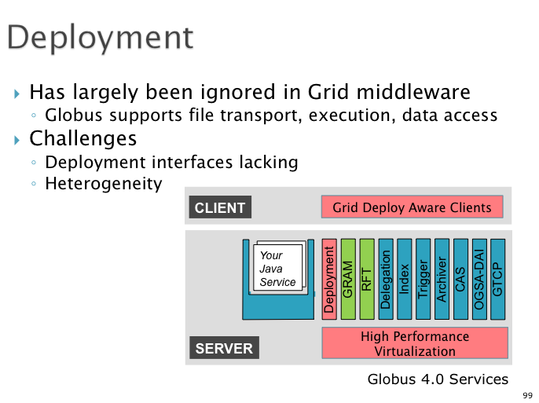
What is the most important aspect of Virtualization/Cloud to you?
Application deployment!

Slide 5
What are your predictions about virtualization and cloud computing
You mean, after the hype?
Policy development
  University Capital expenditure vs recurrent expenditure
  Interesting pricing issues
    1000 processors for one hour is the same as 1 processor for 1000 hours!
Green issues are significant!
Merge of functionality between Grid and Cloud
  Lose much of WS-*?
  Message about standardization?
Virtualization efficiency issues need to be addressed

